Slide 1
TWO APPLICATIONS of JUNGIAN TYPE
Human Development
Decision Making

Slide 2
JUNG and Human Development

Slide 3
TYPE DEVELOPMENT
Preferred sequence of developing each of our four functions
Sensate ____________Intuitive
Thinking __________Feeling
Dominant
Auxiliary
Third
Fourth ( Shadow)

Slide 4
The DOMINANT function
- is the first to develop
- usually our strongest function
- superior in quality
- becomes conscious at age 7-12
- has prime hold on our personality
is developed to the neglect of the opposite
The Dominant Function

Slide 5
The AUXILIARY function
complements the dominant
balances our inner (I) or outer (E) orientation
is developed second at about age 12-adulthood

Slide 6
The THIRD function
from 35 onwards.
The FOURTH function (the Shadow)
comes into consciousness from mid-life to old age

Slide 7
Task: Can you arrange the functions into the order that you have experienced them?
Sensate
iNtuative
Thinking
Feeling
Dominant
Auxiliary
Third
Fourth (Shadow)

Slide 8
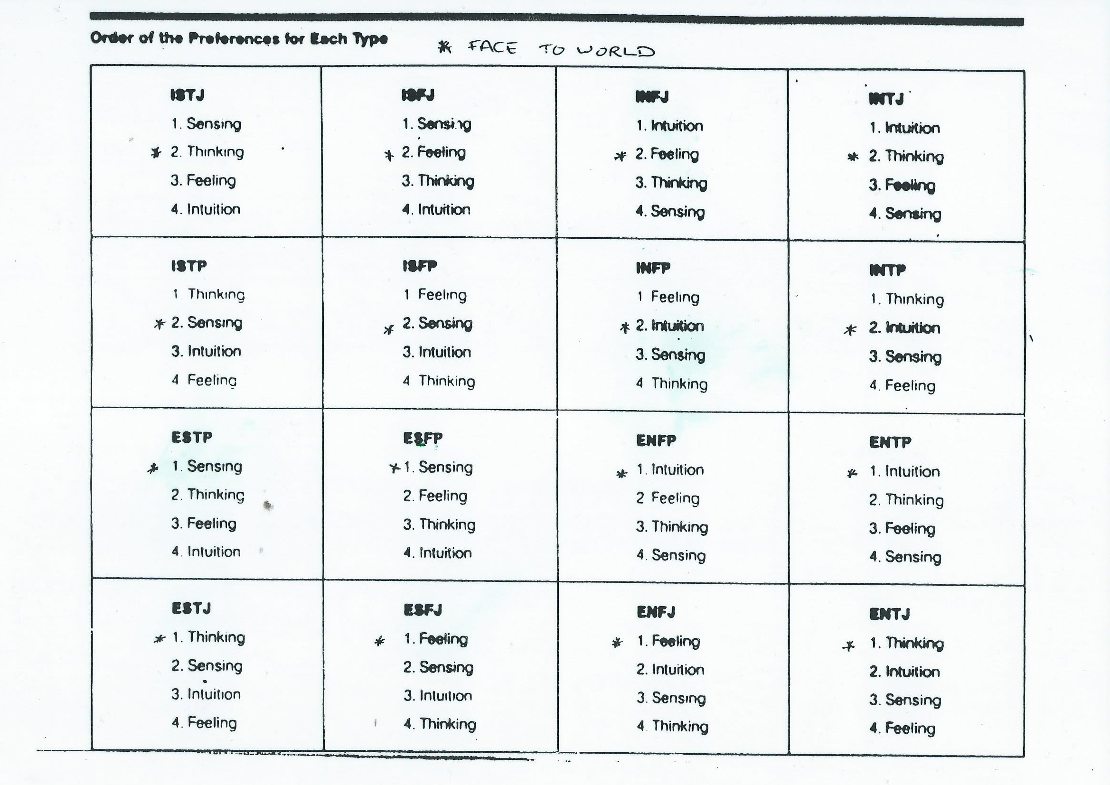

Slide 9
Dominant Function Task: Get a group of people who share your dominant function and discuss the following questions
How does your dominant function effect your life at school?
How are you supported in this function at school?
How does your dominant function effect your life at home? At work? At play?
Are you supported in this function at home? At work? At play?
Can you recall a time when your dominant function kicked in to help with an issue that you were dealing with?
In what ways are you aware of your auxiliary function?

Slide 10
JUNG and Decision-making

Slide 11
Using the functions to make decisions
Thinking
Feeling
Sensate
iNtuative
How could you order the functions to make good decisions?

Slide 12
Moral Dilemma: In groups of four based on dominant function: one of each (If possible, S, N, T, F)
You are a member of the Victorian government or opposition working on a difficult proposition in law.
A lawyer’s client has significant debts to an underworld figure, probably over crime-related activities. The client has confided to the lawyer that they intend to commit armed robbery to cover the debts. The lawyer is inclined to dismiss the threat as idle, but isn’t certain. Should the lawyer report the threat to the police or should the lawyer remain silent as the principle of confidentiality between lawyer and client demands?
Should there be a law that compels the lawyer to report such threats?
How do you make the decision?

Slide 13
