Slide 1
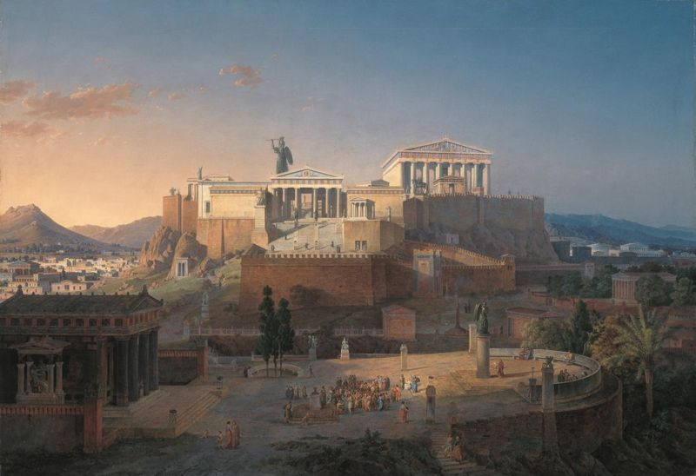
Those ANCIENT GREEKS
Socrates
Plato
Aristotle

Slide 2
PHILOSOPHY
Philia (FRIENDSHIP LOVE)
Sophia (WISDOM)
Athenian Thinkers

Slide 3
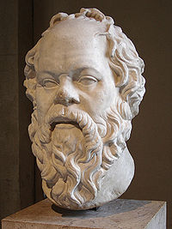
SOCRATES – Who? c. 469 BC–399 BC
Argued against the Sophists (e.g. Protagoras, who tended to be relativists): Through a questioning process that leads from a hypotheses taken from human experience, Socrates seeks the true nature, the essence, the unconditional, unqualified definition of the quality or object under consideration.

Slide 4
SOCRATES - Activity
What is Justice?
Using Socratic Method
The way to TRUTH is deep questioning

Slide 5
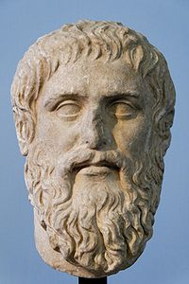
Plato – Who? 428 BC– 348 BC
Was taught by Socrates.
writer of philosophical dialogues, and founder of the Academy in Athens, the first institution of higher learning in the Western world.
Ultimate Truth is beyond all but the philospher. The invisible world of FORMS is the most intelligible

Slide 6
PLATO - Activity
The allegory of the cave
Youtube
Draw your own image of the cave.

Slide 7
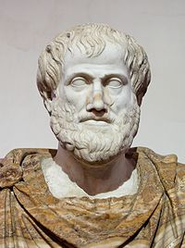
ARISTOTLE – Who? 384 BC – 322 BC
Was taught by Plato
Knowledge is possible and must be of unchanging universal and necessary truths. However, this is not to be found in the realm of the Forms, as Plato suggests, but in the real or natural world. The grouping of things by kind is not an arbitrary human classification but points the truth of the subject.

Slide 8
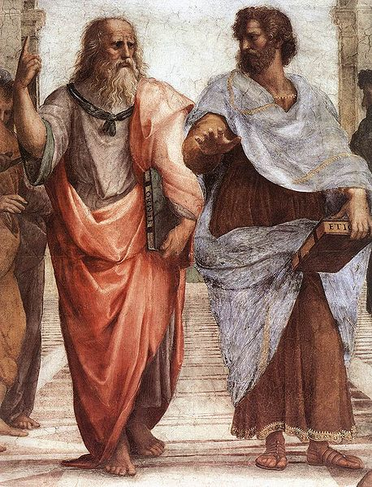
ARISTOTLE – Activity
The School of Athens, a fresco by Raphael.
Which is Plato and which is Aristotle?
Explain?
Answer on the next slide

Slide 9
Plato (left) and Aristotle (right), a detail Aristotle gestures to the earth, representing his belief in knowledge through empirical observation and experience, while holding a copy of his Nicomachean Ethics in his hand, whilst Plato gestures to the heavens, representing his belief in The Forms

Slide 10
Summary
Socrates: TRUTH can be known through rigorously questioning our experience
Plato: TRUTH is real but beyond the world of ordinary experience.
Aristotle: TRUTH is present everywhere if we have the eyes to see

