Slide 1
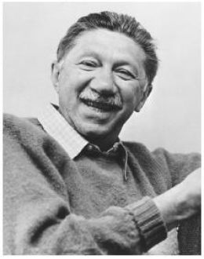
Maslow’s Hierarchy of Needs

Slide 2
What motivates people?
Maslow wanted to understand what motivates people. He believed that individuals possess a set of motivation systems unrelated to rewards or unconscious desires.
Maslow (1943) stated that people are motivated to achieve certain needs. When one need is fulfilled a person seeks to fulfil the next one, and so on

Slide 3
The Needs
The earliest and most widespread version of Maslow's (1943, 1954) hierarchy of needs includes five motivational needs, often depicted as hierarchical levels within a pyramid.
- Physiological
- Safety
- Belonging
- Self Esteem
- Self-actualisation

Slide 4
The Pyramid

Slide 5
Why the idea is a hierarchy
We must satisfy lower level basic needs before progressing on to meet higher level growth needs. Once these needs have been reasonably satisfied, it may be possible to reach the highest level called self-actualization.
Every person is capable and has the desire to move up the hierarchy toward a level of self-actualization. Unfortunately, progress is often disrupted by failure to meet lower level needs. Life experiences including divorce and loss of job may cause an individual to fluctuate between levels of the hierarchy.
Maslow’s Pyramid https://www.youtube.com/watch?v=BNXSnSk8h7Q

Slide 6
Maslow said…
'It is quite true that man lives by bread alone — when there is only bread. But what happens to man’s desires when there is plenty of bread and when his belly is chronically filled?
At once other (and “higher”) needs emerge and these, rather than physiological hungers, dominate the organism. And when these in turn are satisfied, again new (and still “higher”) needs emerge and so on. This is what we mean by saying that the basic human needs are organized into a hierarchy of relative prepotency' (Maslow, 1943, p. 375).
Abraham Maslow Theory - Abraham Maslow Hierarchy Needs
https://www.youtube.com/watch?v=D0BXnTSHtIo

Slide 7
Applying the theory
Hierarchy of Needs in Ratatouille https://www.youtube.com/watch?v=tzQ9vrvTAtk

